Slide 1
AI & Machine learning
Experimenting with Cognitive Computing
By Alberto Valverde Escribano
Senior R&D Engineer

Slide 2
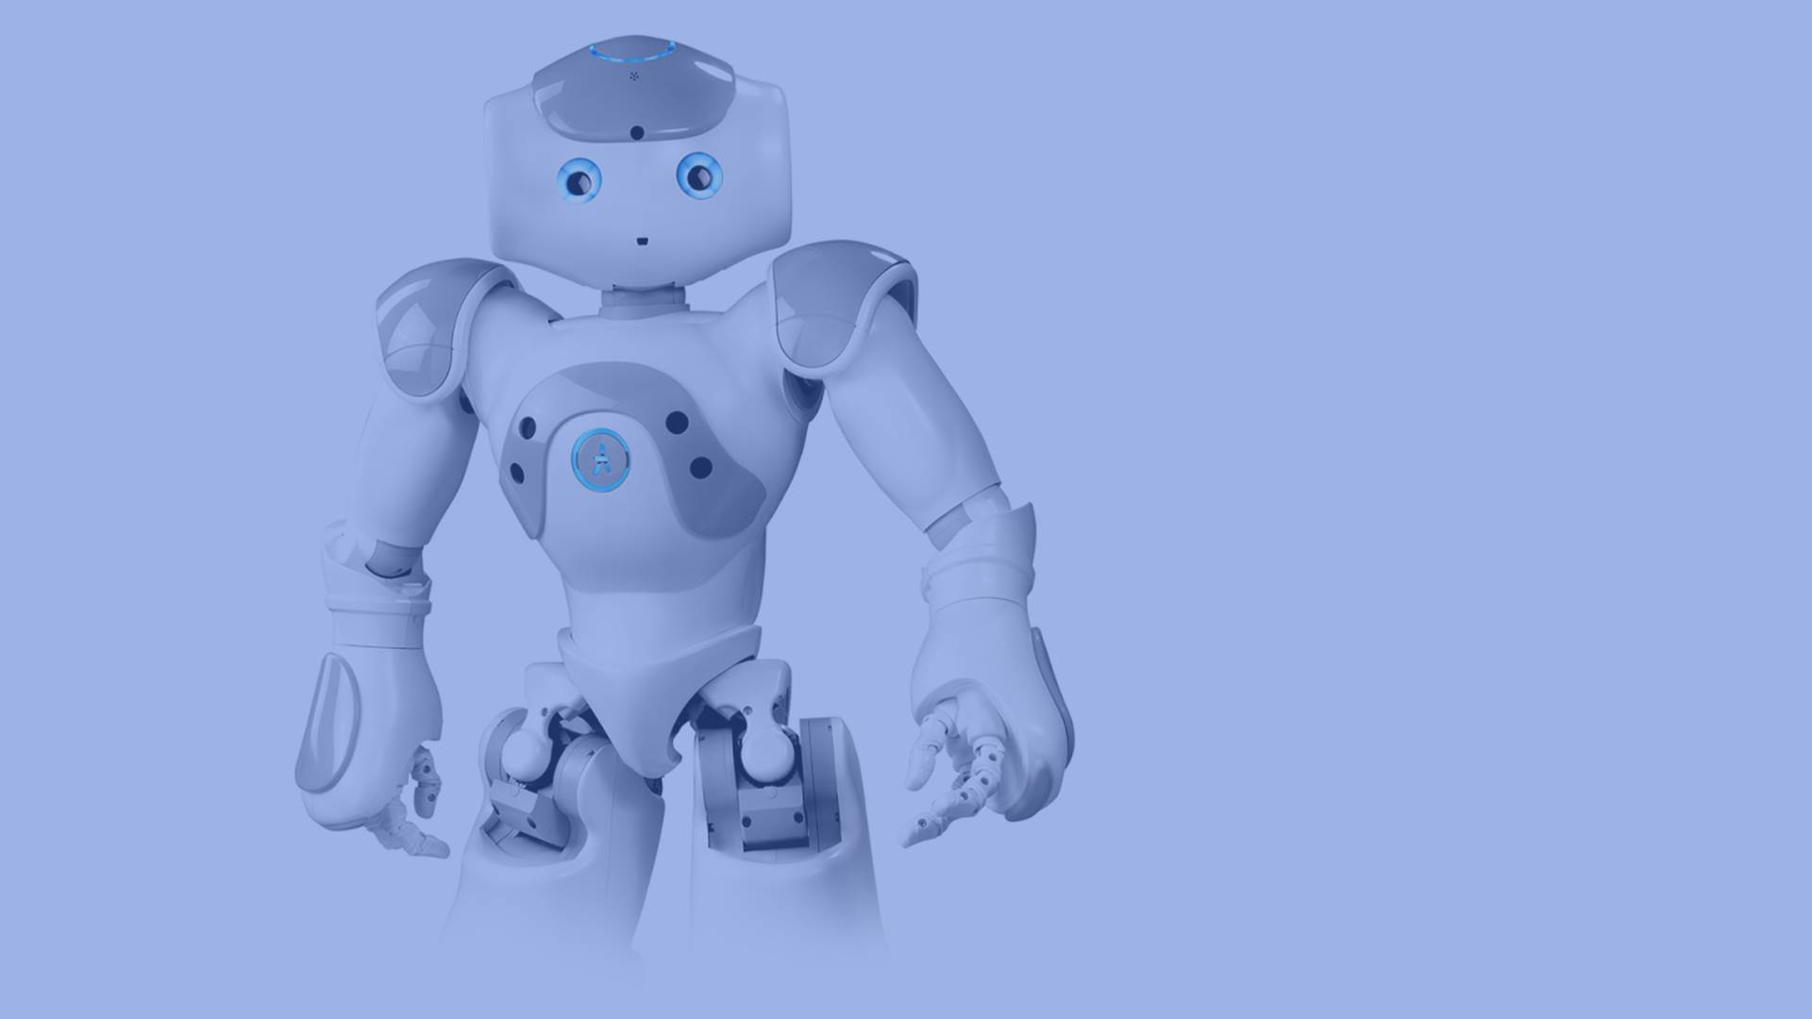
WELCOME
DEMO

Slide 3
Introduction
ESSI is a humanoid robot with abilities to see, talk and hear. He interacts with humans in a natural way and he never stops learning. He is a pretty clever colleague and friend.
Initially, the endgame of the Essilor Virtual Agent work was to demonstrate the accessibility and power of cognitive systems through the cloud-based platform.
To this end, I adopt this robot for research and work with him. In 3 months, I and my technical/coding experience were able to teach a robot to be able to introduce a vision therapeutic application for children - a demonstration of how accessible/impressive the artificial intelligence really is.
As part of my further work with Essi I now leverage numerous Cloud services. These services include the Visual Recognition, Natural Language Classifier (NLC), Speech to Text, and Personality Insights services. The robot program that I am written now enables a person to control the robot verbally.
Essi´s capabilities could also be demonstrated with other devices like web applications or tablets. But the humans like more to interact with the robots.

Slide 4
Natural Language Classifier
DEMO

Slide 5
Cognitive computing
Cognitive computing is the simulation of human thought processes in a computerized model. Cognitive computing involves self-learning systems that use data mining, pattern recognition and natural language processing to mimic the way the human brain works. The goal of cognitive computing is to create automated IT systems that are capable of solving problems without requiring human assistance.
Cognitive computing systems use machine learning algorithms. Such systems continually acquire knowledge from the data fed into them by mining data for information. The systems refine the way they look for patterns and as well as the way they process data so they become capable of anticipating new problems and modeling possible solutions.
Cognitive computing is used in numerous artificial intelligence (AI) applications, including expert systems, natural language programming, neural networks, robotics and virtual reality.

Slide 6
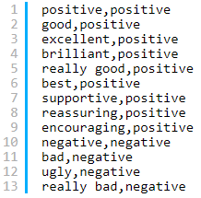
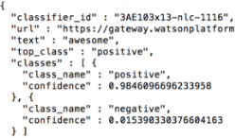
Machine Learning - Classify Natural Language
The statistical algorithms interprets the intent behind text and returns a corresponding classification with associated confidence levels. The return value can then be used to trigger a corresponding action, such as redirecting the request or answering a question.
In the scenario below I have two classes – positive and negative.
After the training of the neural network is done, here is a request for the word “awesome” which was not in the initial training data.
The Cloud service returns not only one class but up to the top five classes with the highest confidence levels.
awesome = positive

Slide 7
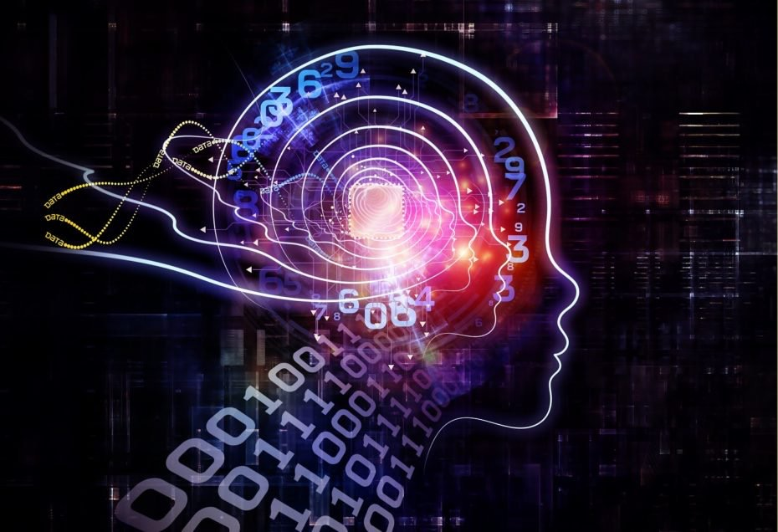
ESSILOR VIRTUAL AGENT
Essilor Virtual Agent (experiment) is a new way to provide automated services to the customers. It offers a cognitive, conversational self-service experience that can provide answers and take action.
The agent fit the specific business needs, provide custom content and and deep analytics provide insights on your customer's engagement with the Essilor Virtual Agent and help with the understanding of your constantly changing customer's needs.
The virtual agent understands natural-language and responds to customers in human-like conversation –in multiple languages.
Natural language queries and processing
Machine learning algorithms
Real-time computing

Slide 8
DIGITAL SIGNAGE ADVERTISING (in-Store)
VISION THERAPY FOR CHILDREN (in-Store)
CHATBOT / ADVISOR (online)
Customer support (Tone analyzer)
Technical support
Custom Product Search
Add, Remove and List items in Shopping Cart
Product advisor
Order tracking management
BUSINESS APPLICATIONS

Slide 9
HUMAN-ROBOT ITERATION - HOW IT WORKS
To analyze — spoken or written — commands in natural language and automatically determine their intent, this application uses three cloud-based services.
Natural language recognition & response
Cognitive Services - Cloud
Speech to text service
Spoken speech input
Written output
Conversation Service
Application
Written speech input
Text to speech servicer
Spoken output

Slide 10
VISUAL RECOGNITION - HOW IT WORKS
An intelligent visual recognition service that automatically analyzes and identifies objects and scenes in image files (video, etc.).
Object & scene recognition
Visual Recognition
Images
Classifier
Application
Training
Model

Slide 11
Vision therapeutic application game for children
DEMO

Slide 12
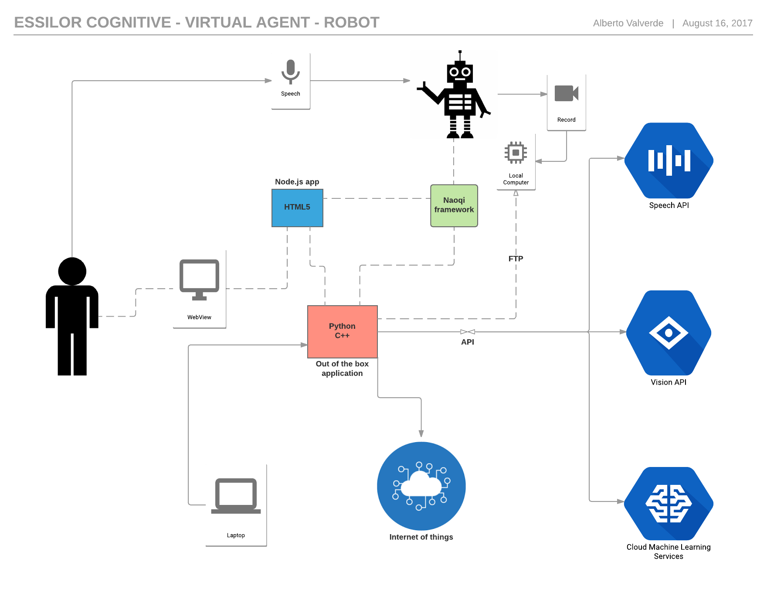

Slide 13
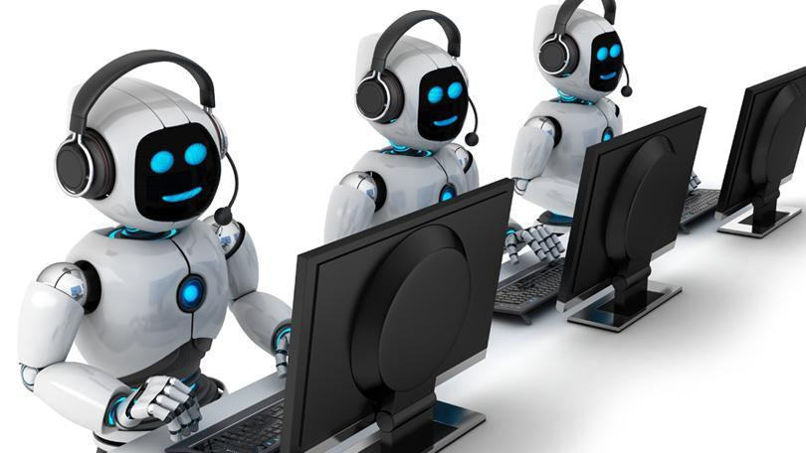
CHATBOT
Transform your customer experience with bots
Chatbots are an essential way to let users interact with organizations. They speak the same language we do, can answer questions and offer support at a moment's notice. By adding a natural language interface to your app, website or device or even to messaging apps and social channels, bots can break down the barriers to fast, efficient customer communications.

Slide 14
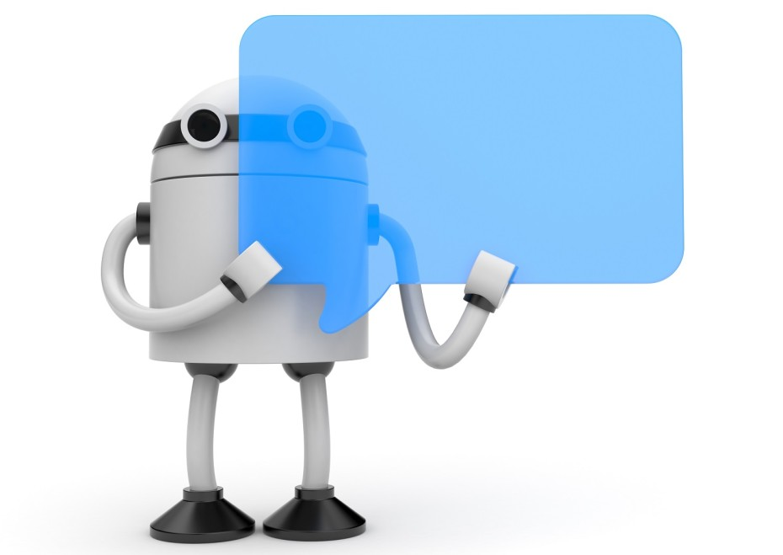
CHATBOT
DEMO

Slide 15
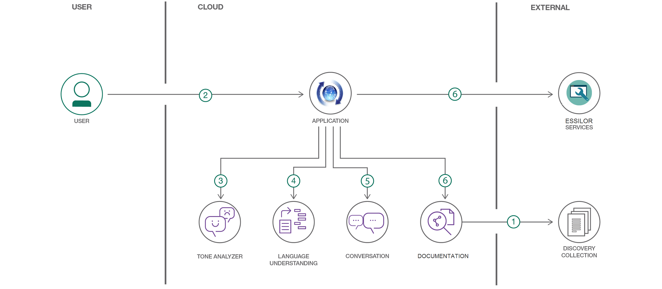
The FAQ documents are added to the System Cloud collection Machine learning algorithms.
The user interacts with a chatbot via the app UI.
User input is processed with Tone Analyzer to detect anger. An anger score is added to the context.
User input is processed with Natural Language Understanding (NLU). The context is enriched with NLU-detected entities and keywords (e.g., a location).
The input and enriched context is sent to conversation service. Conversation recognizes intent, entities and dialog paths. It responds with a reply and/or action.
A requested action is performed by the app. This may include one of the following:
Lookup additional information from Essilor services to append to the reply
Use Cloud System to reply with an answer from the FAQ documents

Slide 16
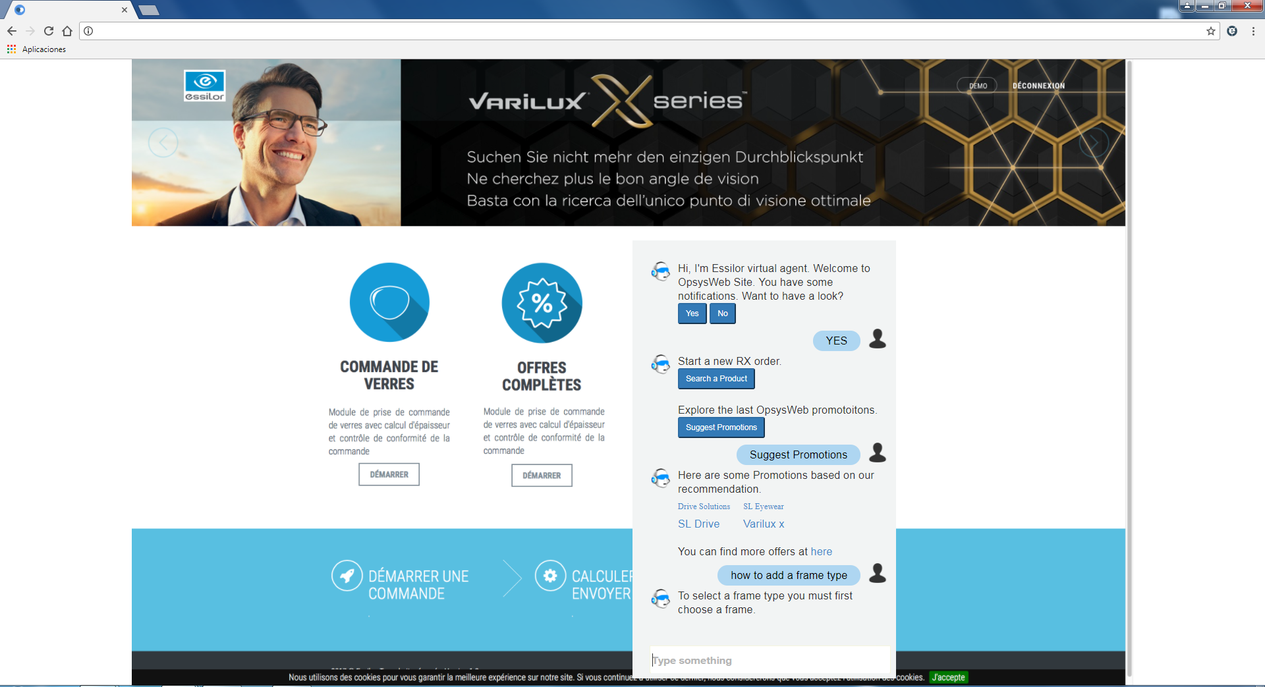

Slide 17
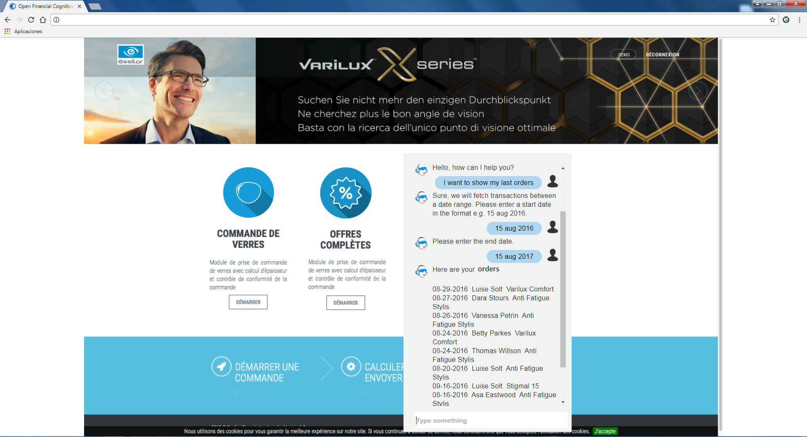

Slide 18
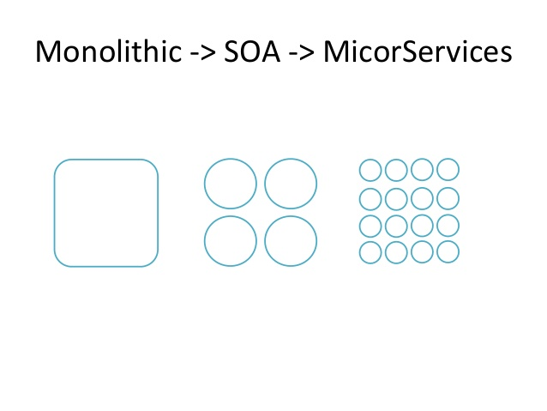

Slide 19
Thanks you for attending!
Contact
Phone: +34 608 837 254
Email: valveraa@essilor.es
Online: https://sites.google.com/essilor.com/creativity/

